Slide 1
IBM University Engagement Project Submission
“Exploring the Power of Agentic AI with IBM Granite and IBM Bob”

Slide 2

Project Tile – GridShield AI
Domain of Project – Energy & Power Distribution + Artificial Intelligence
Student Name | Recent Passport Photo | Email ID | Mobile number [WhatsApp]
Om Chandrakar |  | chandrakarom934@gmail.com | +91 9302446510

Slide 3
Problem Statement -
Problem Statement No.18 - AI Agent for Electricity Bill Fraud Detection
The Challenge
Electricity fraud and billing anomalies lead to major financial losses for power distribution companies. With thousands of consumers and massive billing data, detecting suspicious consumption patterns manually is extremely difficult. Utilities need an intelligent AI system that can automatically analyze electricity usage data and identify potential fraud cases.
The Objective
Build an AI Agent for Electricity Bill Fraud Detection that analyzes electricity consumption and billing records to detect abnormal patterns and flag potential fraud cases.
The solution should:
Electricity Consumption Analysis – Analyze consumer electricity usage data to understand normal consumption behavior and trends.
Fraud Pattern Identification – Detect suspicious activities such as sudden drops in usage, unusual spikes, or inconsistencies between meter readings and billed units.
AI-Based Anomaly Detection – Automatically identify consumers whose usage patterns significantly deviate from normal historical behavior.
Explainable AI Insights – Provide clear explanations for why a particular consumer or electricity bill is flagged as suspicious.

Slide 4
Proposed Solution -
GridShield AI
The proposed solution is an Agentic AI-powered Electricity Fraud Detection and Investigation Platform built using IBM Bob, IBM Langflow / IBM Orchestrate, and IBM Granite Models to analyze electricity consumption and billing records.
GridShield AI identifies abnormal patterns such as sudden consumption drops, unusual spikes, historical deviations, and meter-to-billing inconsistencies using AI-based anomaly detection.
The system consists of five specialized agents:
Data Analysis Agent – analyzes consumption and billing history.
Anomaly Detection Agent – identifies unusual patterns.
Fraud Investigation Agent – correlates suspicious indicators.
Explainability Agent – explains why a consumer was flagged.
Decision Support Agent – provides risk level and recommended action.
A web-based dashboard allows investigators to analyze consumers, view anomalies, understand AI-generated evidence, manage investigation cases, and generate reports.
IBM Langflow / IBM Orchestrate orchestrates the agent workflow, while IBM Granite Models provide AI reasoning and explainable insights.
Overall, GridShield AI transforms electricity data into actionable, explainable fraud-investigation intelligence while keeping the final decision with human investigators.

Slide 5
Technology Used
IBM Bob Platform – For designing and orchestrating the Agentic AI workflow.
IBM Langflow / IBM Orchestrate – For connecting and coordinating multiple AI agents.
IBM Granite Model – For reasoning, investigation analysis, explanation, and generating AI insights.
IBM Cloud – For secure and scalable deployment of the application and AI services.
RAG – For retrieving relevant electricity consumption and billing information before generating investigation insights.
Python – For data processing, feature analysis, and anomaly detection.
FAISS / Chroma Vector Database – For efficient retrieval of relevant electricity and billing records.

Slide 6
Required Files created using IBM bob -
Required Files created using IBM Bob –
Backend – main.py – FastAPI application entry point
agents/watsonx_agents.py – 5-Agent IBM watsonx.ai pipeline
services/anomaly_detection.py – Electricity anomaly detection
services/ingestion.py – Data validation and cleaning
services/analysis.py – Consumption profiling and analysis
Frontend – React + Vite – Dashboard and investigation interface
api.ts – Frontend–Backend API integration
requirements.txt – Python dependencies
.env.example – IBM watsonx.ai configuration
report_service.py – PDF investigation report generation
Core Agent Files:
DataAnalysisAgent
AnomalyDetectionAgent
FraudInvestigationAgent
ExplainabilityAgent
DecisionSupportAgent

Slide 7
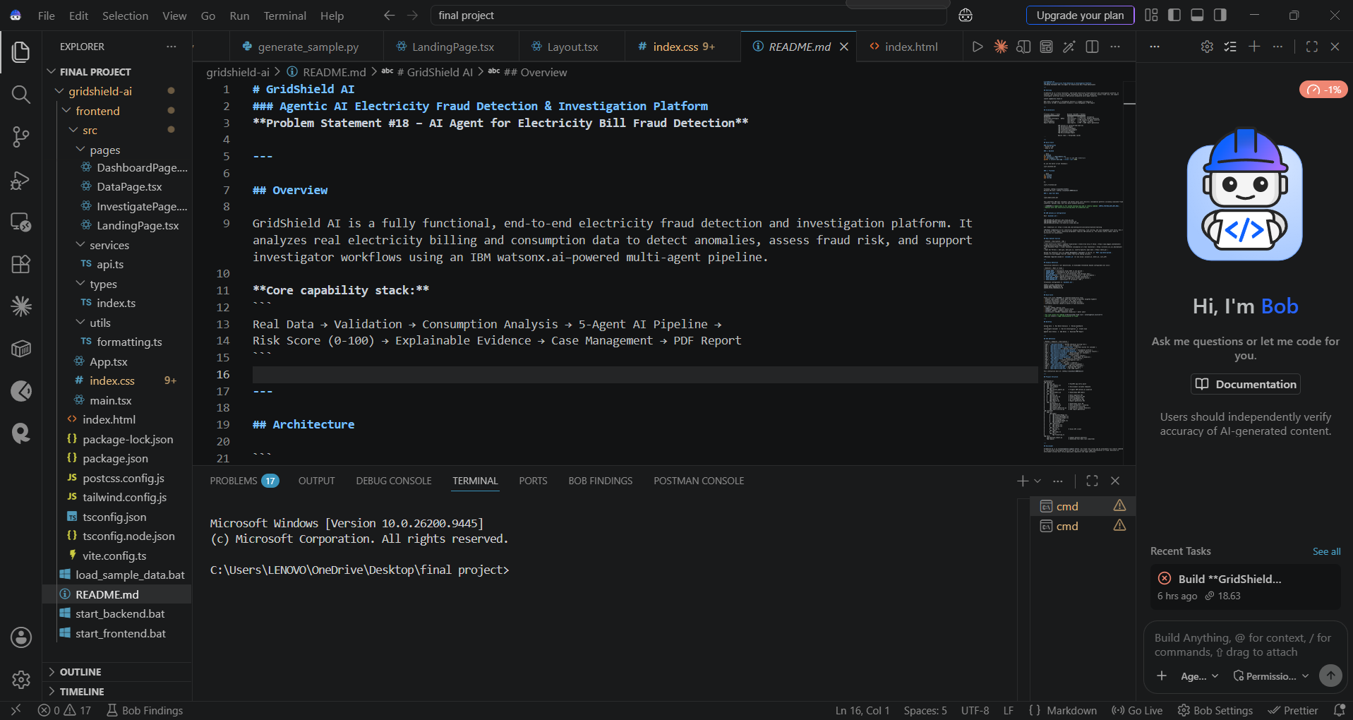
IBM Bob Screenshots:

Slide 8
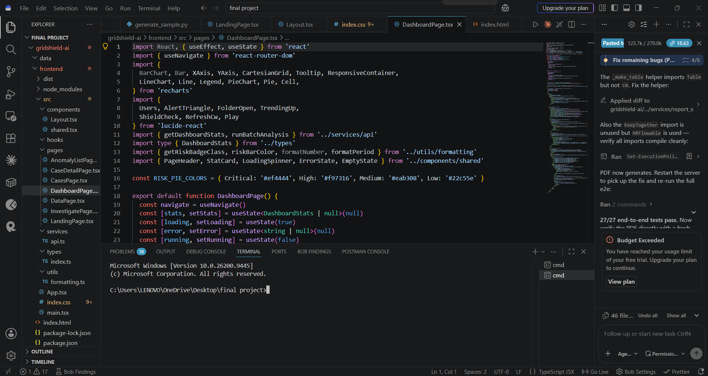

Slide 9

Role of Agentic AI in the solution
Role of Agentic AI in GridShield AI
Data Analysis Agent – Analyzes consumer billing and electricity consumption history.
Anomaly Detection Agent – Detects unusual consumption patterns and billing/meter inconsistencies.
Fraud Investigation Agent – Correlates multiple anomalies to identify potentially suspicious cases.
Explainability Agent – Explains the evidence and reasons behind each flagged case.
Decision Support Agent – Generates risk priority and recommends the next investigation action.
Agent Collaboration – Agents work together through the workflow to provide an automated, evidence-based investigation, while the final decision remains with the human investigator.

Slide 10
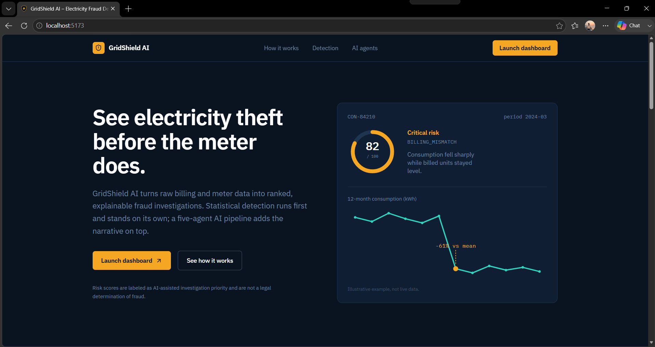
Project Output Screenshot
·
·
·

Slide 11
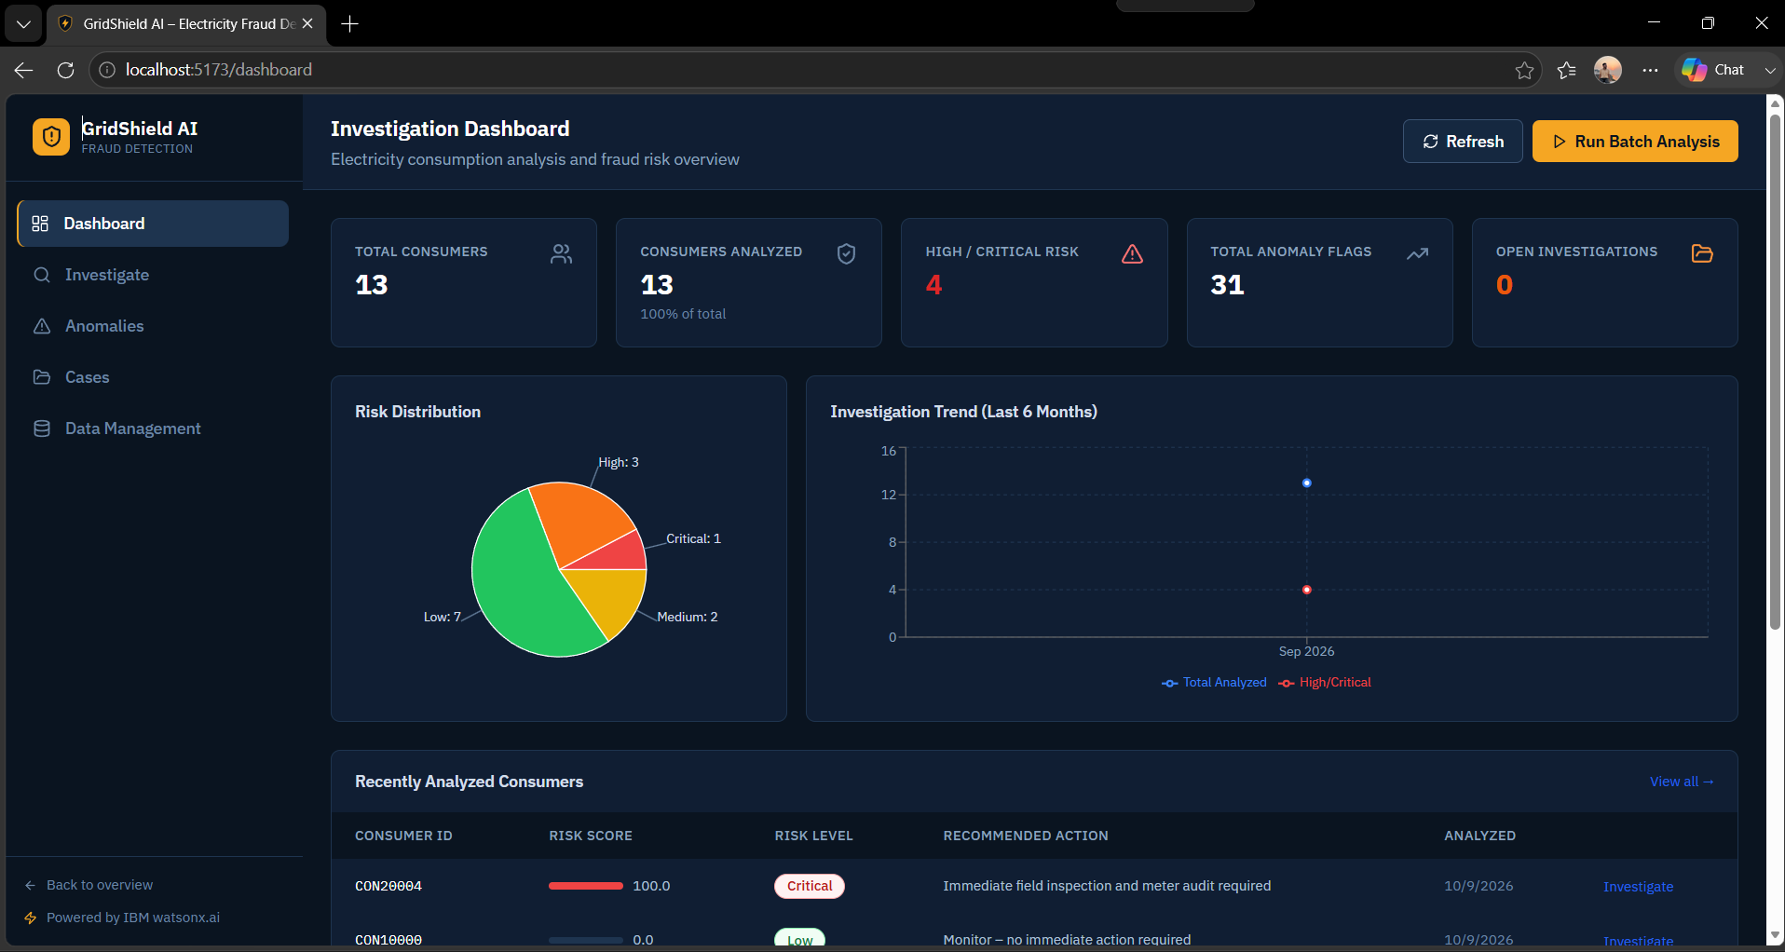
Project Output Screenshot
·
·
·

Slide 12
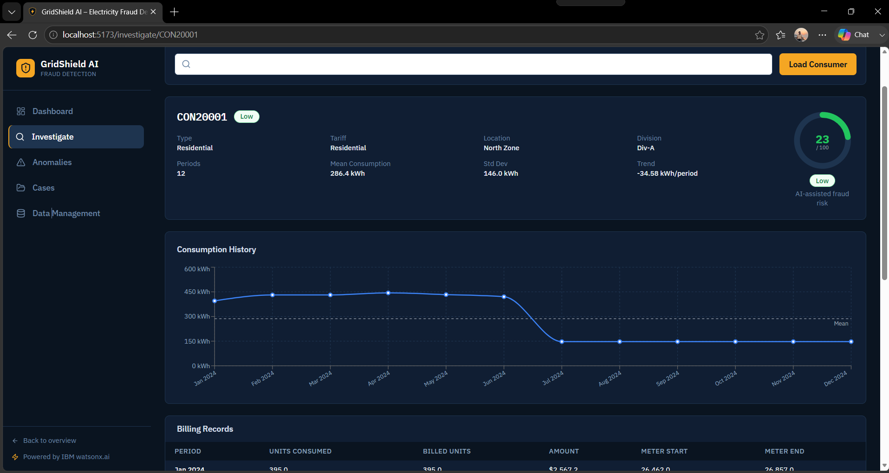
Project Output Screenshot
·
·
·

Slide 13
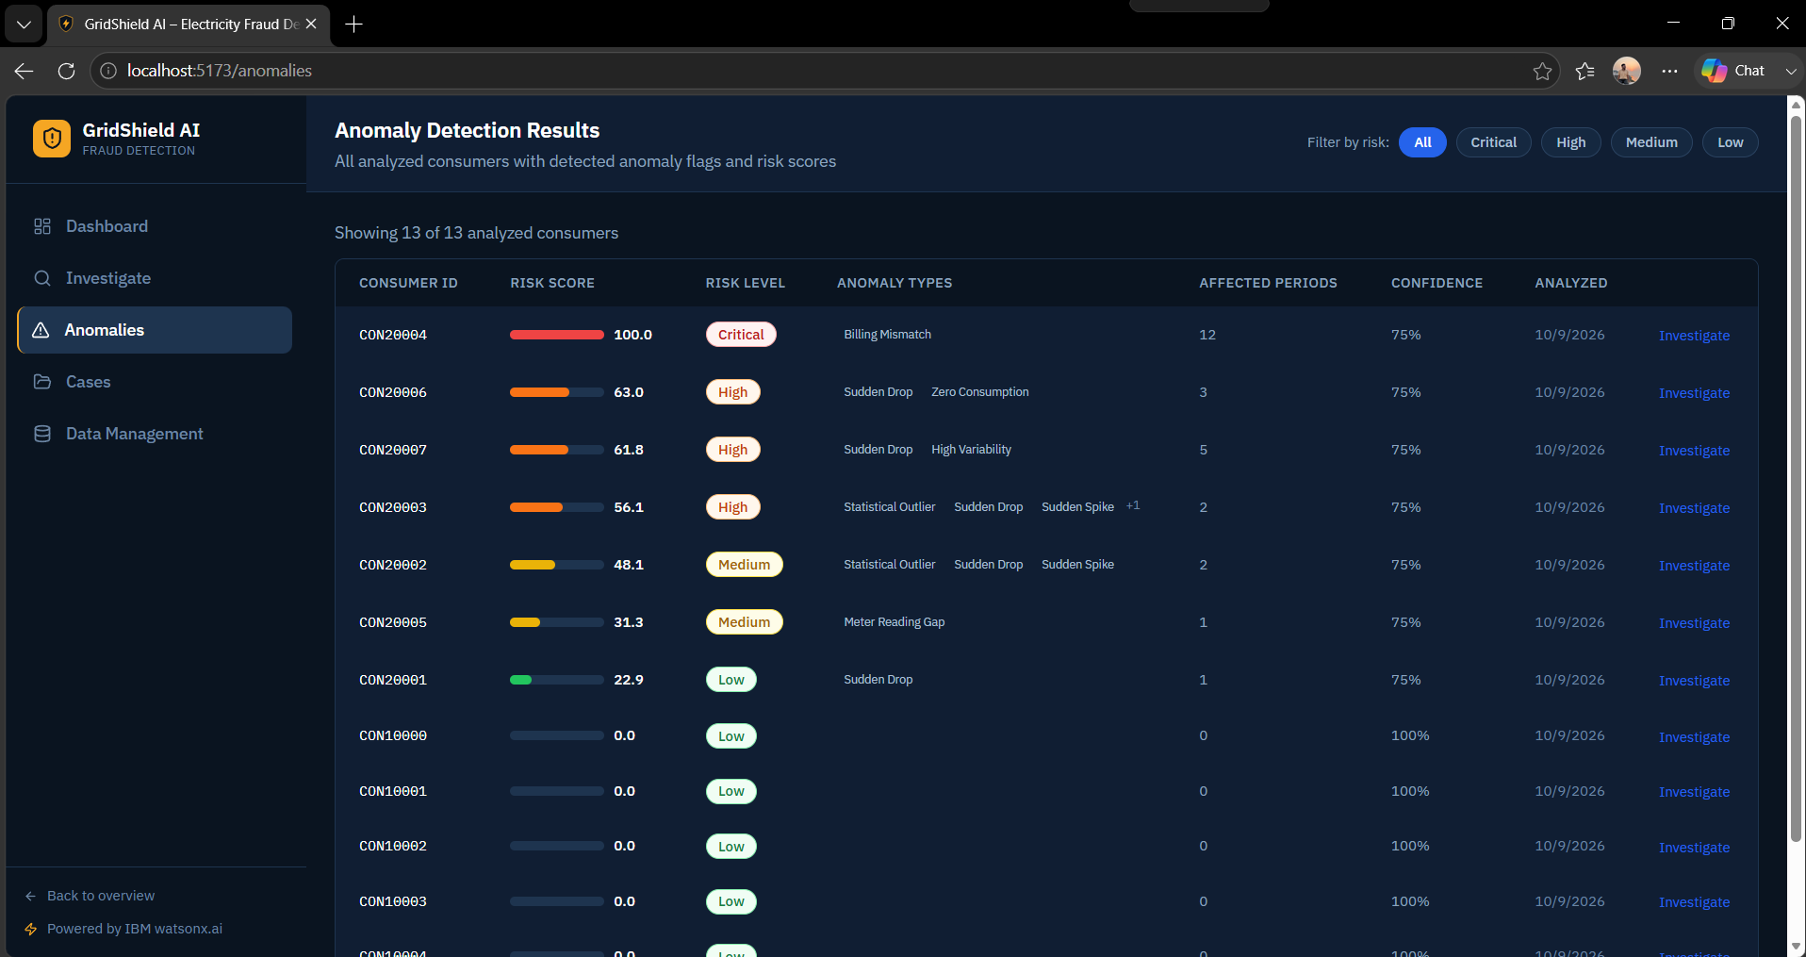
Project Output Screenshot
·
·
·

Slide 14
IBM Bob prompt
Build GridShield AI, a fully functional Agentic AI Electricity Fraud Detection & Investigation Platform based on the following Problem Statement details:
The system should analyze electricity consumption and billing data to identify suspicious patterns such as sudden consumption drops, unusual spikes, abnormal consumption deviations, and meter/billing inconsistencies. It should use AI-based anomaly detection to identify potentially fraudulent or suspicious cases and provide clear, explainable insights showing why a consumer was flagged.
The platform should provide investigators with an end-to-end workflow covering data ingestion, validation, consumption analysis, anomaly detection, AI investigation, risk assessment, explainable evidence, recommended actions, case management, and report generation.
Use IBM Langflow / IBM Orchestrate and IBM Granite Models to implement a functional multi-agent architecture with specialized agents for data analysis, anomaly detection, fraud investigation, explainability, and decision support.
The system must generate a dynamic 0–100 investigation risk score based on actual analyzed evidence and classify cases into Low, Medium, High, or Critical. The AI should provide supporting evidence, affected billing periods, historical comparisons, reasoning, and recommended investigation actions.
Build a professional investigation dashboard with consumer analysis, anomaly monitoring, case management, AI investigation, data management, and report generation. All metrics, charts, AI results, and reports must come from actual processed data.
The final application must be fully functional and end-to-end, with real data processing, working AI agents, proper API integration, database support, error handling, and no fake results, hardcoded AI decisions, dead buttons, or placeholder workflows.

Slide 15
Novelty and Uniqueness
Multi-Agent Intelligence – Five specialized AI agents collaborate to analyze, investigate, explain, and prioritize suspicious cases.
Behavior-Based Anomaly Detection – Detects unusual consumption patterns, sudden drops, spikes, meter gaps, and billing inconsistencies.
Explainable Fraud Investigation – Provides evidence-based explanations showing why a consumer was flagged instead of giving only a risk score.
Dynamic Risk Scoring – Generates a 0–100 AI-assisted investigation priority score based on anomaly severity, frequency, and available historical data.
Automated Case Management – Converts suspicious findings into investigation cases with status tracking, notes, and timelines.
Evidence-Based Reports – Generates structured PDF reports containing anomalies, risk assessment, evidence, and recommended actions.
End-to-End Intelligence – Connects real electricity data → anomaly detection → AI investigation → risk assessment → case management → report generation.

Slide 16
Git Hub Link
The Working Github URL – https://github.com/omchandrakar17/GridShield-Ai
·
·
·

Slide 17
Future Scope
Real-Time Fraud Detection – Continuously monitor electricity consumption and detect suspicious patterns.
Smart Meter Integration – Connect directly with smart meters and IoT devices for live data.
Advanced AI Models – Improve fraud prediction using machine learning and advanced IBM Granite models.
Automated Investigation – Enable AI agents to automatically prioritize and investigate high-risk cases.
Utility System Integration – Integrate with electricity billing and utility management systems.
Mobile Application – Provide investigators with a mobile-based case monitoring and inspection system.
·
·
·

Slide 18
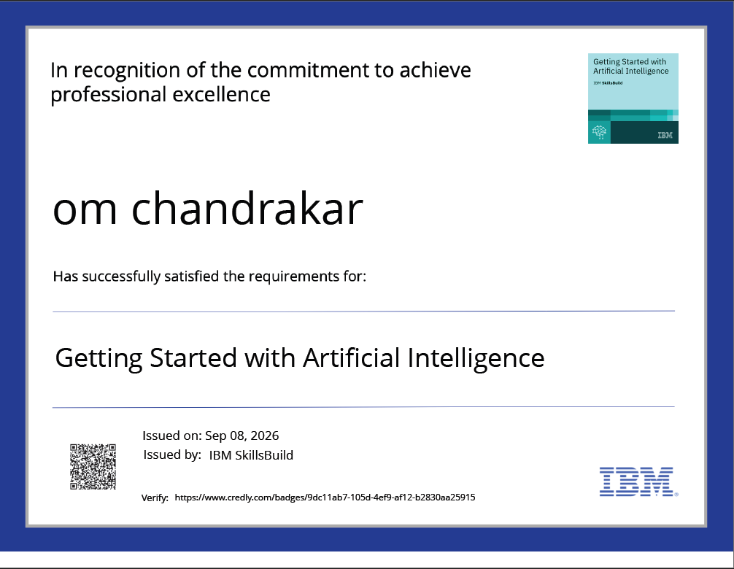
Certificates Earned:
Please add your credly certificate

Slide 19
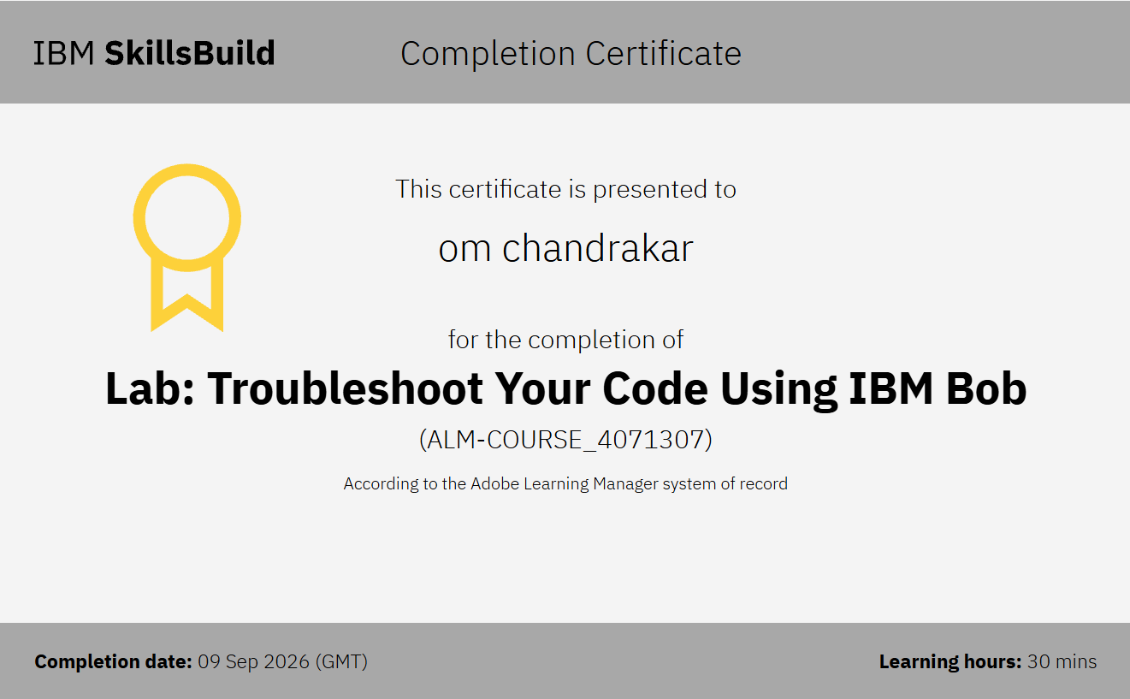
Certificates Earned:​
Add your IBM BOB Certificate

Slide 20


